Slide 1



Automated Qualitative Thematic
Analysis of Mental Health in Social Media Posts
Surya Appana, University of California, Berkeley (presenting author)
Ikhoon Eom, National University of Singapore
Jia Jun Tan, National University of Singapore
Ministry of Health, Office of Healthcare Transformation (MOHT), Singapore

Slide 2

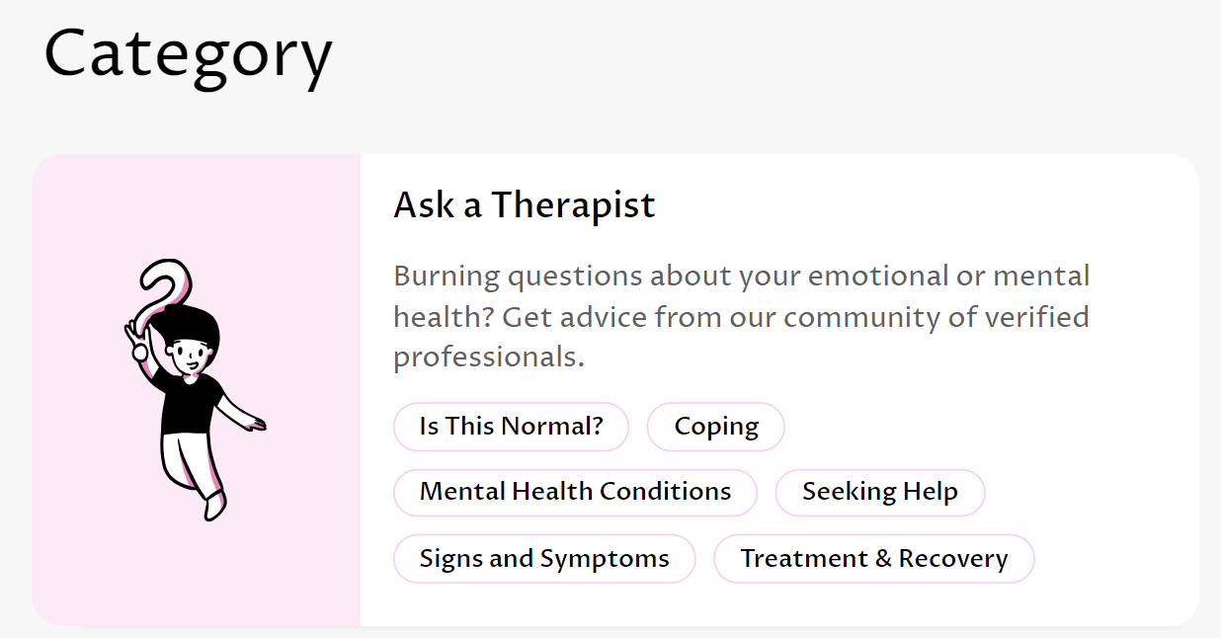
Introduction
Motivation:
Social media provides the opportunity for individuals to express mental health concerns.
Such concerns are of particular interest to healthcare organizations for making policy decisions.
Singapore’s Ministry of Health, Office of Healthcare Transformation (MOHT):
Conducts broad-level healthcare analyses and projects to influence healthcare decisions in Singapore
Operates a social media platform, called Let’s Talk, which is focused on mental health conversations & includes an interactive feature between individuals and therapists.

Slide 3
Introduction
Unsupervised Natural Language Processing (NLP) through topic modeling provides new ways of discovering insights about mental health using social media text data.
Uncovering hidden topics and their distributions
Hidden structure related to mental health
In this project, we aimed to discover such insights specifically as they relate to the goals of MOHT - mental health in Singapore

Slide 4
Objectives
Determine an optimal topic modeling algorithm for our dataset
Research questions Let’s Talk posts
What are the overall topics discussed on the forum, and which ones are most popular?
Which topics engage users more?
Do the topics shift over time? If so, are there trends?
Compare Let’s Talk users with users from other forums:
Are there any differences between Let’s Talk and other popular websites in Singapore & other countries in terms of topics, user engagement, etc.?
Final goal: develop a pipeline by which practitioners can better understand the discussions and mental health of users on the Let’s Talk forum and respond accordingly.

Slide 5
Project Overview
Topic Clustering of Let’s Talk Posts
Understanding Let’s Talk Users
User Engagement Analysis
Time Series Analysis for Topic Distributions
Comparing With Other Platforms
Let’s Talk Forum
Assigning thematic labels for each post
Automated Mental Health Analysis Pipeline
Periodic analysis report

Slide 6
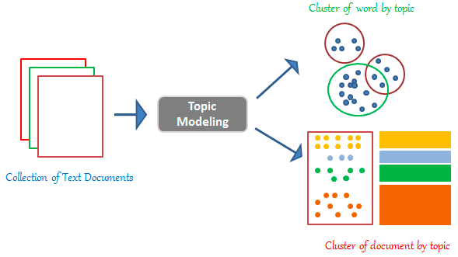
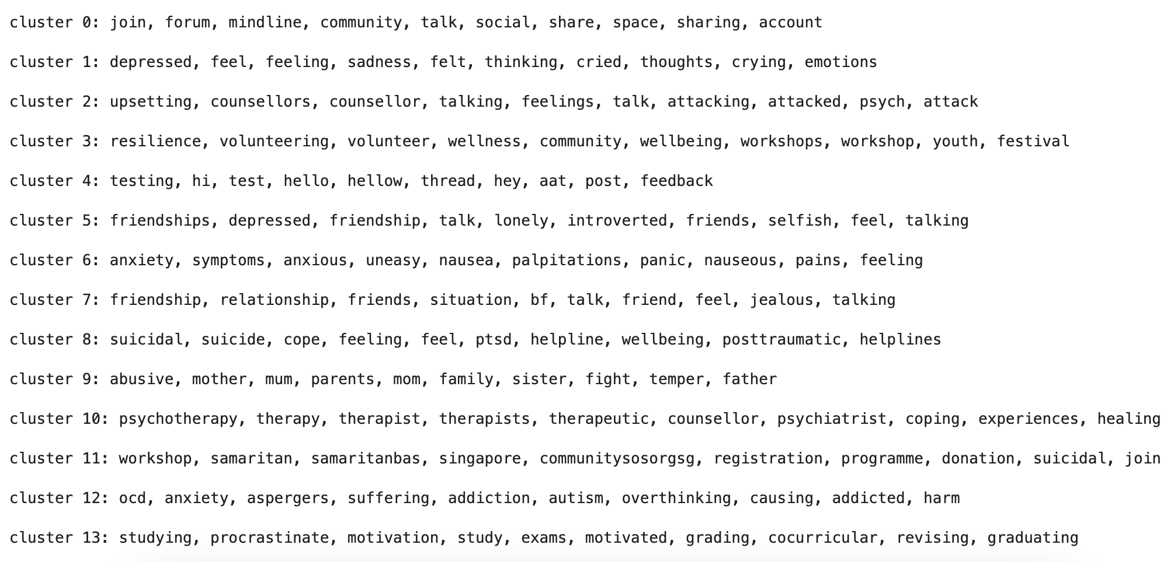
Methods
Our task requires a topic modeling algorithm to cluster user posts together based on topic
Four algorithms:
Latent Dirichlet Allocation (LDA): probabilistic model
Nonnegative Matrix Factorization (NMF): V = W * H
Top2Vec (embedding-based)
BERTopic (embedding-based)

Slide 7
Methods
Our task requires a topic modeling algorithm to cluster user posts together based on topic
Four algorithms:
Latent Dirichlet Allocation (LDA): probabilistic model
Nonnegative Matrix Factorization (NMF): V = W * H
Top2Vec (embedding-based)
BERTopic (embedding-based)
Final choice: BERTopic
Best DBCV score (Density-Based Clustering Validation)
Visual and qualitative analysis of topics yields the best results
Better able to capture semantic and contextual meanings through the BERT transformer

Slide 8
Methods
Bidirectional Encoder Representations from Transformers (BERT):
A well known transformer baseline for NLP experiments
Able to capture semantics, emotions, and meanings behind various vocabularies within their respective contexts.
BERTopic:
Embeds text into vectors using a pre-trained BERT model (trained on a massive Reddit dataset) & performs dimensionality reduction (nonlinear) on these vectors
Uses the embeddings to cluster documents (posts) into groups (using hierarchical clustering)
Outputs a topic representation for each group (sequence of words) indicative of each group’s topic.

Slide 9
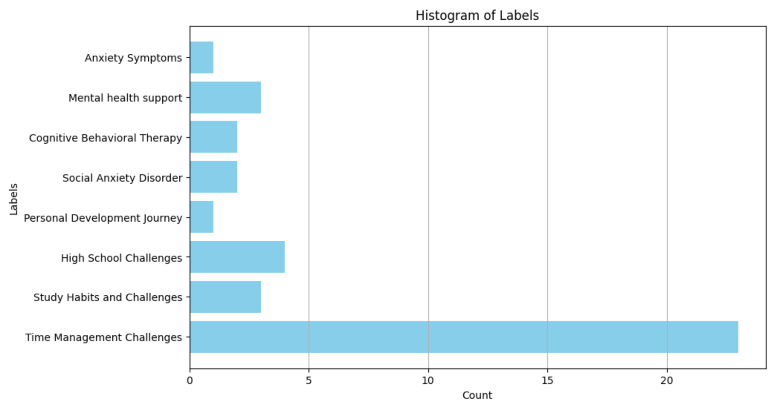
Methods
BERTopic is stochastic:
UMAP (dimensionality reduction) is stochastic in nature
Resulting number and quality of clusters and topic representations are slightly different each time BERTopic is run
Question: can we better distill the inherent topics after running our algorithm multiple times?
Idea:
Aggregate all topic representations across many trials and cluster them based on a word frequency-based model - e.g. Nonnegative Matrix Factorization
Backtrack from these new clusters to determine the topic distribution of each post
Example Post and Topics

Slide 10
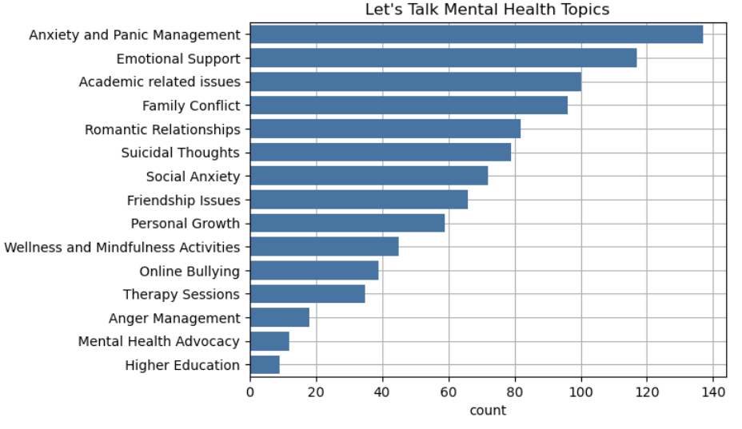
Topics Discovered on Let’s Talk Dataset
Summarizing the discovered topic representations into short descriptions, we came up with 15 distinct topics.

Slide 11
Examining User Engagement
Having discovered the topics, we aim to answer:
1) Are there differences in user engagement between individual topics?
2) What are the topics individual users tend to focus on?
We refer to engagement of users with the entire discussion following an initial post.
Variables:
likes count, posts count, total word count, reads count, count of words in initial post
Statistical test for differences between medians across topic groups:
Kruskal-Wallis test is significant at the 0.05 level for all of the above user engagement variables.
Total word count has the smallest p-value

Slide 12
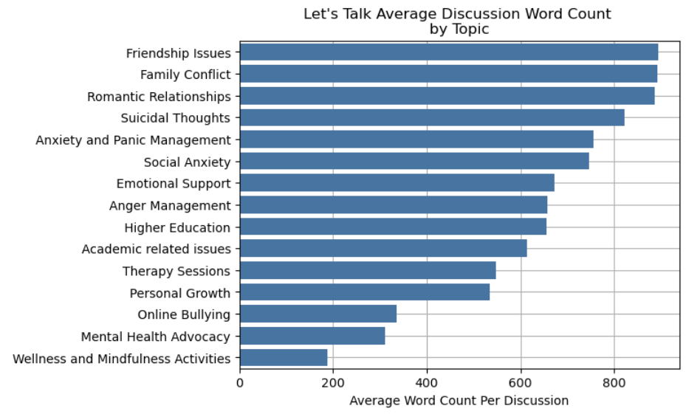
Examining User Engagement
Q: Are there differences in user engagement between individual topics?
Discussions about friendship issues, family conflicts, and romantic relationships seem to have the most total words on average
Discussions about online bullying, mental health advocacy, and wellness and mindfulness activities seem to have the fewest total words on average

Slide 13
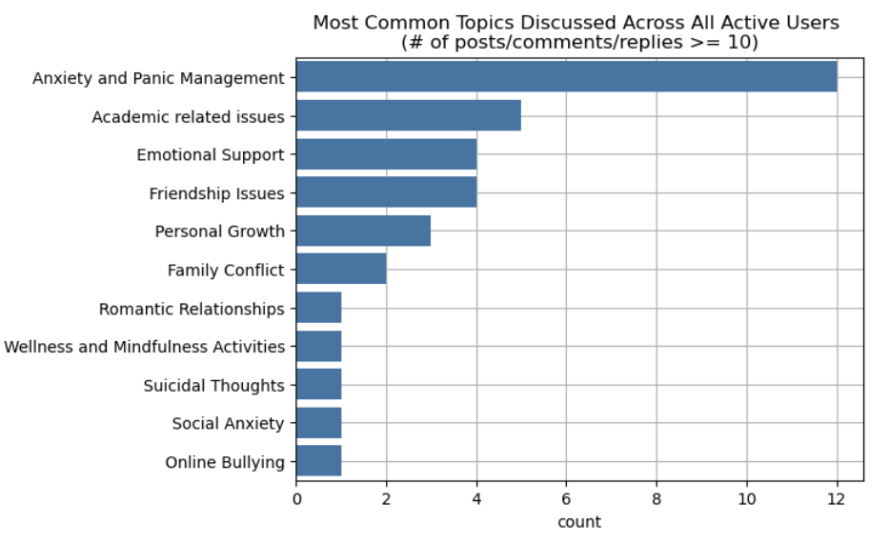
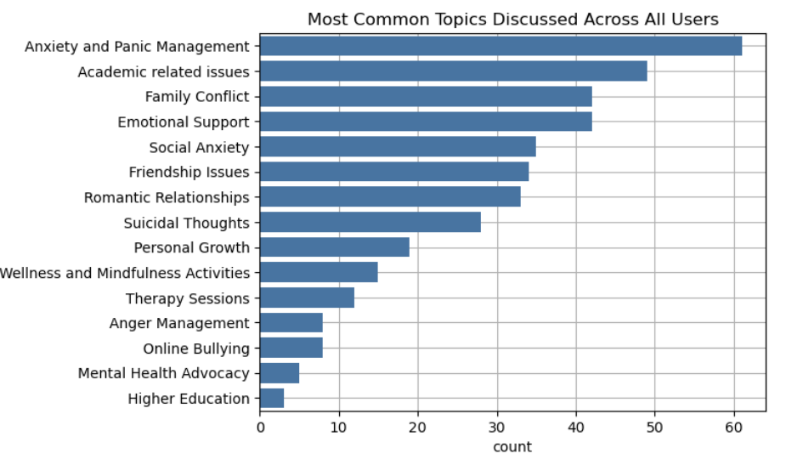
Examining User Engagement
Q: What topics do individual users tend to focus on? - For this, we care about the “active” users, which we define to mean users who have made a post, comment, or reply at at least 10 times on the entire forum
Count refers to the number of users for which that topic is the topic they engage most in (across all of their posts/comments/replies)
Anxiety and Panic Management and Academic related issues are the most common
Social Anxiety drops in rank when we consider only active users
The other topics approximately retain their ranks when considering only active users.

Slide 14
Comparison with Other Platforms
Motivation:
Let’s Talk is relatively new
Investigating mental health in more popular platforms can inform future decisions on Let’s Talk based on new kinds of conversations that develop as Let’s Talk becomes more popular
Platforms: (chosen based on data availability)
Reddit
HardwareZone -- Singaporean platform originally intended for computer tech related discussions, but has broadened over time

Slide 15
Datasets
Reddit dataset:
~80k posts after cleaning on Reddit mental health posts from a Hugging Face dataset that concern adhd, depression, aspergers, ocd, and ptsd.
We performed our topic clustering on a sample of 1500 posts (for each of adhd, depression, etc.) for convenience
HardwareZone dataset:
Scraped ~500 posts using search keywords: e.g.
“anxiety,” “depression”
“mental trauma|struggling|stressed|difficult recover -News -Study -Survey”
“feeling stress life -News -Study -Survey”

Slide 16
Comparison with Other Platforms
Several topics appear in the Reddit and HardwareZone datasets which do not exist as topics in the Let’s Talk data:
Food/Nutrition in Reddit data
Drugs/substances in Reddit data
Job/Workplace stress in HardwareZone
There is only one academic-related topic that shows up (within the ADHD Reddit dataset), but for Let’s Talk, academic-related issues is the third most common topic.
⇒ Academics is highly mentioned/discussed among Let’s Talk users, but this is not the case for Reddit and HardwareZone.

Slide 17
Possible Future Work
Soft clustering with Gaussian Mixture Models to determine topic probabilities for each post
Examining suicidal ideation for individual users to accelerate responses from therapists
Determining user intents for coming to Let’s Talk (or any other forum)

Slide 18
Thank You

